Slide 1
Project 1 – Box Office Oracle
What Make a Top 10 Box Office Movie?
Isabel Buechsel
Grace Chan
Jason Do
Fathi Elshibani

Slide 2
What Make a Top 10 Box Office Movie?
Sources: Box Office Mojo, OMDb, YouTube, Twitter
APIs: OMDb, YouTube, Twitter

Slide 3
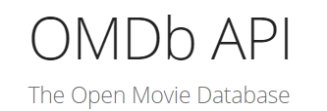

Slide 4
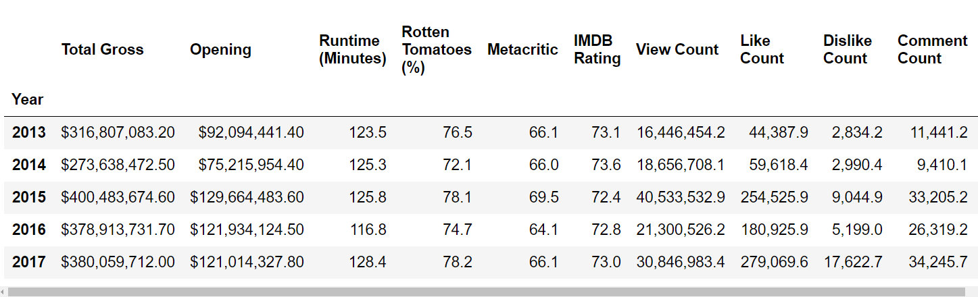
5 Year Average Trend

Slide 5
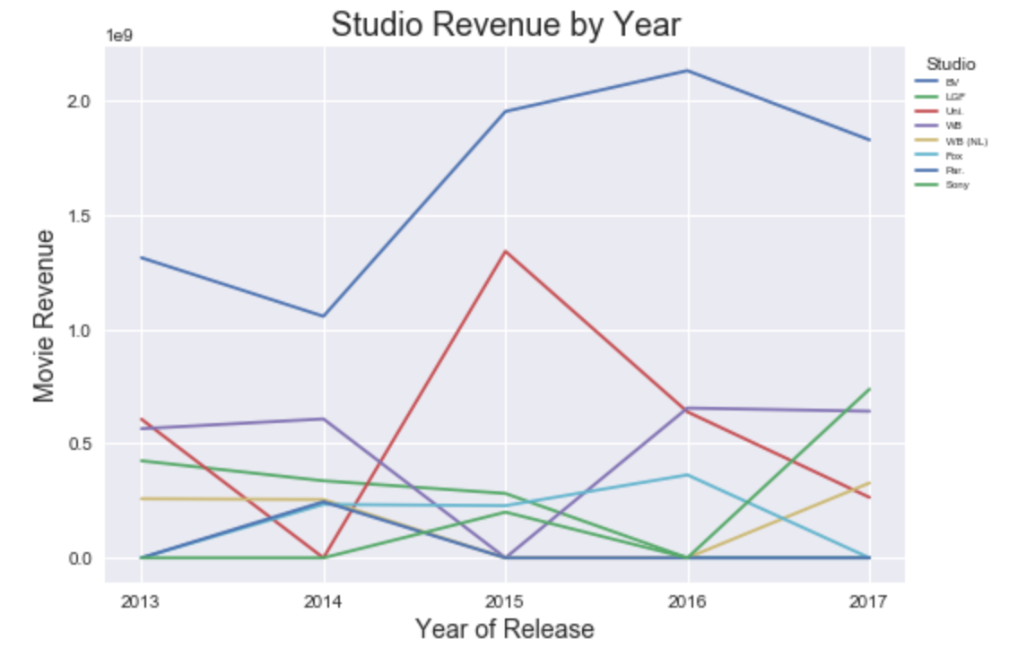

Slide 6
Movie Ratings (MPAA)
Impact on Average Gross Per Movie
Only 4 top 10 movies were either rated G or R
The group rating with the highest average gross per movie is PG-13

Slide 7


Slide 8
Official Movie Trailer View Count v. Overall Gross
Question: Do movie trailer views indicate what the overall gross of a movie would be?
Assumption: Viewing a movie trailer indicates general interest in the movie
Process:
- YouTube Search API: use 3 keywords(“Movie” + “Trailer” + Movie Title) to return a Video ID
- YouTube Video API : use Video ID to return statistics on the video

Slide 9
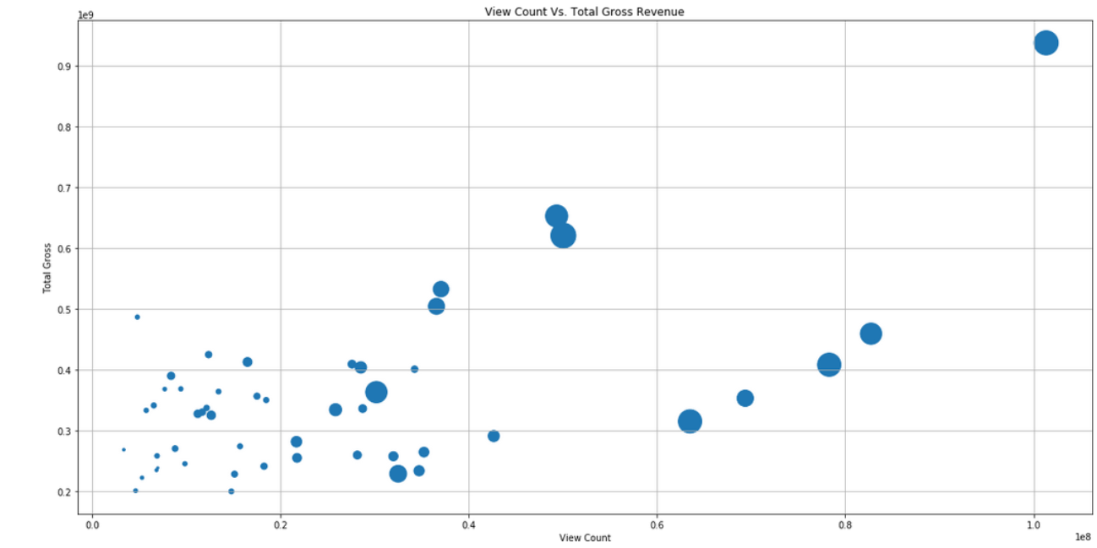
Official Movie Trailer View Count v. Overall Gross
Bubble Size: Like Count

Slide 10

Star Wars: The Force Awakens had the highest number of movie trailer views and also the highest overall gross revenue

Slide 11



Most Video Likes:
757,954
Most Video Dislikes: 52,071
Most Video Comments:
141,470

Slide 12

Release Date

Slide 13
Release Date of Top 10 Movies
Question: Does the month of the release date have an impact on the overall gross of a movie?
Assumption: There will be more Top 10 movies released during the summer and winter months to correspond with the time students are on break.
Process:
- Use CSV file containing data from Box Office Mojo to gather the release date
- Find corresponding month from release date data

Slide 14


Top 10 Movies by Release Month
Top Winter Movie: December 18
Top Spring Movie
June 12

Slide 15



Director

Slide 16





Directors with the most top 10 movies in the last 5 years
Interesting Fact: Only one female director (with top director credit) had a top 10 movie in the past 5 years
Patty Jenkins for Wonder Woman

Slide 17

Director
Challenges

Slide 18
Challenges:
Twitter Movie Mentions and Sentiment
Weather
Production Budget Data

Slide 19
Challenges: Twitter Movie Mentions and Sentiment
Question: Do the number of Twitter mentions and overall sentiment indicate what the overall gross of a movie would be?
Assumption: More Twitter mentions would generally correlate with a higher overall gross.
Process:
- Looking at Twitter mentions using hashtags
- Looking at Twitter movie handles
Issue:
- Understanding how the average Twitter user tweets
Resolution:
- Used the YouTube API instead

Slide 20
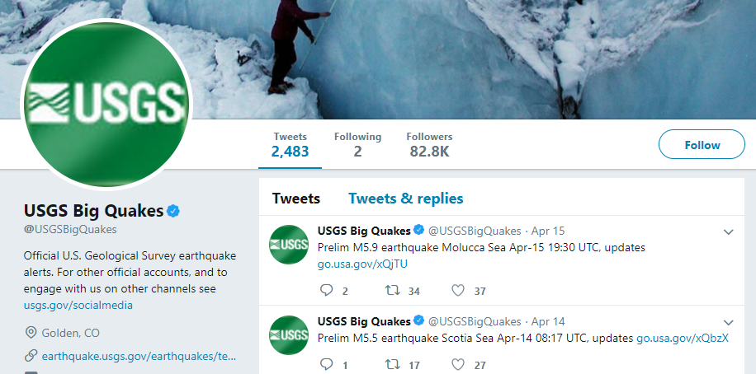

Challenges: Twitter Mentions
Twitter Mentions
How does the average twitter user tweet?
Do users tweet at the handle or use hashtags?
Assumption:
If people are tweeting about a movie they do not normally tweet at the handle
Example:
If there is an earthquake, most users would tweet #earthquake, not tweet @USGSBigQuakes handle
Issues:
Not every movie has its own handle (i.e. @Iron_man for all its movies)
Requires a manual search for handle names

Slide 21


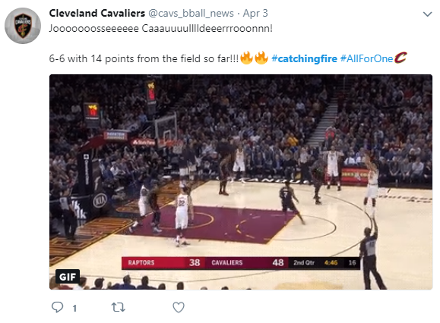
Challenges: Twitter Mentions
Twitter Mentions
How does the average twitter user tweet?
Knowing what hashtags users might use
Some movies need multiple hashtags to return the most relevant tweets
This would have required a manual process of assuming what most people would tweet
#Smaug #DesolationofSmaug #Hobbit
#HungerGames #CatchingFire
#Frozen #Gravity were too common
- Some movies were unique: #BigHero6

Slide 22
Challenges: Weather
Question: Does the weather impact the overall gross of a movie?
Assumption: Poor weather would correlate with a higher overall gross.
Process:
- Analyze cities in different geographical locations and look at the temperature based on the release date
Issue:
- There was no overall gross by city
Resolution:
- Looked at month of release date

Slide 23
Challenges: Production Budget
Question: Does the production budget impact the overall gross of a movie?
Assumption: A higher production budget would generally correlate with a higher overall gross
Process:
- Compare the overall gross of a movie to its total production budget
Issue:
- Some movies did not make their budget data available
Resolution:
- N/A

Slide 24
Key Takeaways:

